Slide 1






Greater Manchester Make Smoking History Programme Educational Seminars Series
Cytisine update: A new treatment for tobacco dependency
July 2024
These slides have sound. Please watch with sound on
Professor Matthew Evison
Consultant Chest Physician
Specialty Lead, Lung Cancer & Thoracic Surgery Directorate, Wythenshawe Hospital, Manchester
University NHS Foundation Trust
Associate Medical Director, Greater Manchester Cancer
Clinical Lead, Make Smoking History, Greater Manchester Regional Tobacco Control Programme, NHS Greater Manchester
MASHC Honorary Clinical Chair, Faculty of Biology, Medicine & Health, University of Manchester

Slide 2
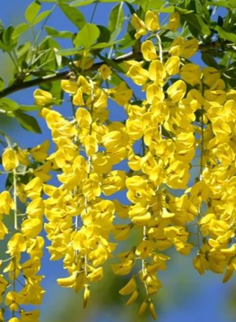
Introduction
Cytisine is a plant-based, naturally occurring chemical found in plants like Laburnum​
Cytisine is a nicotine analogue: it is a partial agonist at the nicotine receptor in the brain and can therefore alleviate withdrawal and cravings to smoke (like varenicline) ​
Strong evidence base across multiple RCTs, meta-analyses and Cochrane database review​
Established in routine clinical care in mainland Europe for many decades ​
Key advantages of Cytisine:​
Plant based, naturally occurring chemical ​
Robust evidence of effectivenaess ​
25-day course can be provided in a single prescription / supply​
Cost saving versus other treatment courses ​
Less side effects compared to other nicotine analogues​

Slide 3

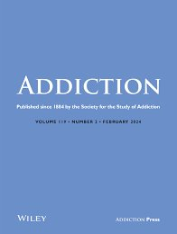

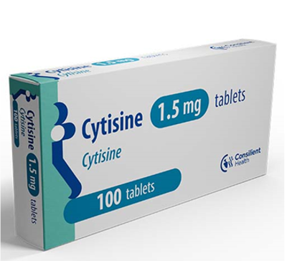

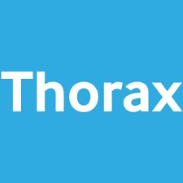
Evidence base

Slide 4
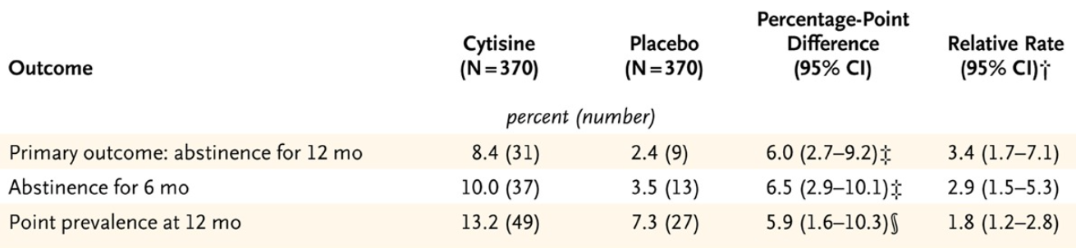
Placebo-controlled trial of cytisine for smoking cessation
Single-centre, placebo controlled RCT (UK)
Primary outcome: 12 month sustained abstinence
740 participants
Cytisine more effective than placebo p=<0.001
Increased GI adverse events with Cytisine than placebo (5.7% higher rate)
Robert West, Witold Zatonski, Magdalena Cedzynska, et al. The New England Journal of Medicine. https://www.nejm.org/doi/full/10.1056/NEJMoa1102035 September 2011

Slide 5

Clinical effectiveness: cytisine vs placebo meta-analysis
Cytisine vs placebo
8 trials: 7 with extractable data
2x high quality studies
RR 1.57, 1.42-1.74 (7 studies)
RR 3.29, 1.84-5.90 (2x high quality studies)
No difference in overall adverse event profile
Increased GI symptoms specifically with Cytisine (RR 1.76, 1.28-2.42)
Hajek P, McRobbie H, Myers K. Thorax 2013;68:1037-1042. https://thorax.bmj.com/content/68/11/1037 February 2013

Slide 6
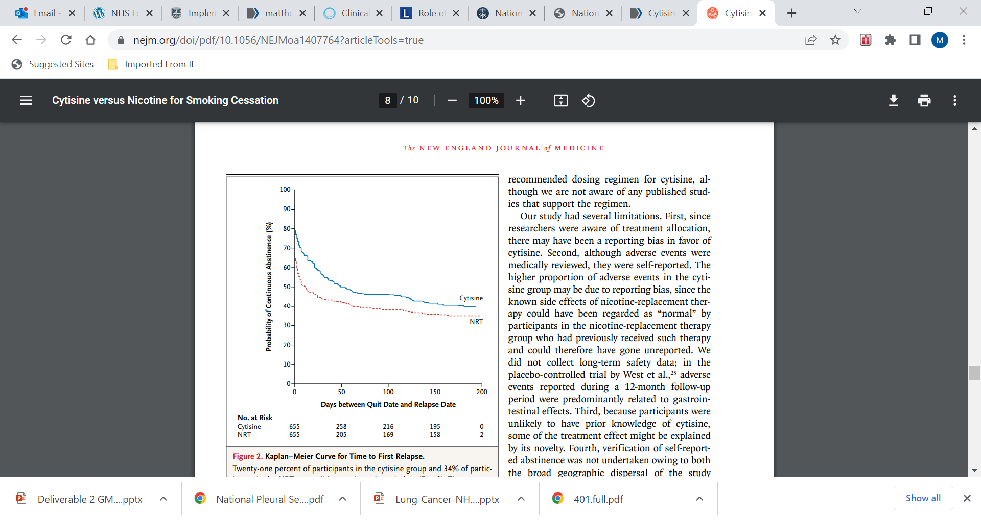
Cytisine vs nicotine for smoking cessation
Non-inferiority RCT (New Zealand)
Cytisine (25 days) vs NRT (8 weeks)
Primary outcome: continuous abstinence at 1 month
40% vs 31%
RR 1.3, 1.1-1.5, p=<0.001
Cytisine NNT 11
Higher adverse events Cytisine
(nausea, vomiting, sleep disturbance)
Cytisine is non-inferior, possibly superior
Natalie Walker, Colin Howe, Marewa Glover, et al. The New England Journal of Medicine. https://www.nejm.org/doi/full/10.1056/NEJMoa1407764 December 2014

Slide 7
Cytisine vs nicotine for smoking cessation in New Zealand indigenous Māori: a randomized controlled trial
Non-inferiority RCT (New Zealand)
679 participants
Cytisine (12 weeks) vs varenicline (12 weeks)
Primary outcome: 6 month abstinence
12.1% vs 7.9%
RR 1.55, 0.97-2.46, p=<0.001
Reduced adverse events with cytisine RR 0.56, 0.49-0.65, p<0.001
Cytisine is non-inferior with fewer adverse events (possibly superior)
Walker N, Smith B, Barnes J, Verbiest M, Parag V, Pokhrel S, Wharakura MK, Lees T, Cubillos Gutierrez H, Jones B, Bullen C. Cytisine versus varenicline for smoking cessation in New Zealand indigenous Māori: a randomized controlled trial. Addiction. 2021 Oct;116(10):2847-2858. doi: 10.1111/add.15489. Epub 2021 May 4. PMID: 33761149; PMCID: PMC8519028.

Slide 8
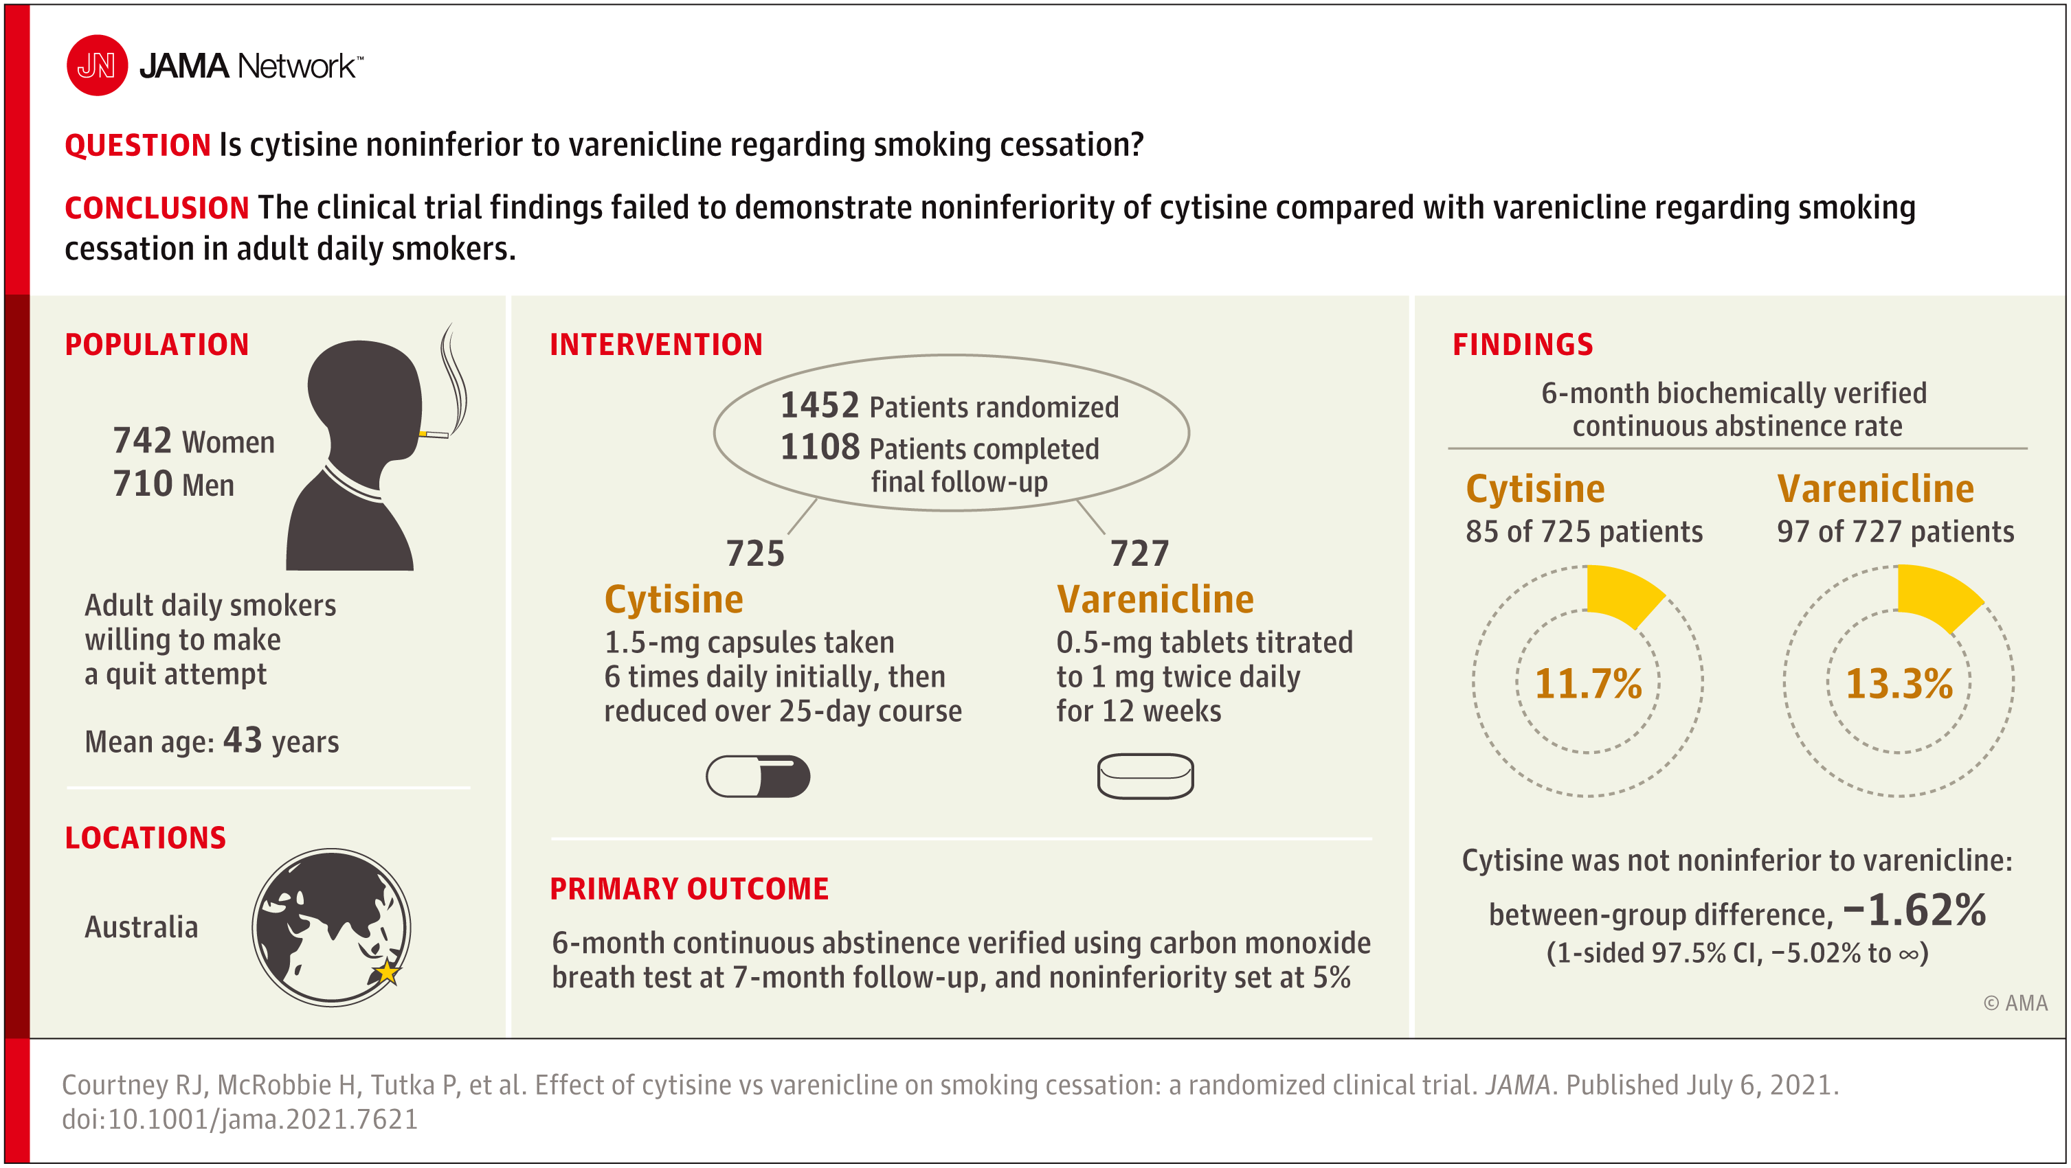

Slide 9
Pharmacological and electronic cigarette interventions for smoking cessation in adults: component network meta-analyses
High‐certainty evidence that…
Nicotine vapes (OR 2.37, 95% CI 1.73 to 3.24; 16 RCTs, 3828 participants)
Varenicline (OR 2.33, 95% CrI 2.02 to 2.68; 67 RCTs, 16,430 participants)
Cytisine (OR 2.21, 95% CrI 1.66 to 2.97; 7 RCTs, 3848 participants)
...were associated with higher quit rates than control.
E-cigarettes, varenicline and cytisine are the most effective stop-smoking aids, analysis of over 150,000 smokers reveals
On average, for every 100 people trying to quit, around 14 are likely to succeed using an e-cigarette, varenicline or cytisine in any given quit attempt. This is compared to 6 in 100 who are likely to quit without any aids.
Source: E-cigarettes, varenicline and cytisine are the most effective stop-smoking aids, analysis of over 150,000 smokers reveals | Cochrane
Lindson N, Theodoulou A, Ordóñez-Mena JM, Fanshawe TR, Sutton AJ, Livingstone-Banks J, Hajizadeh A, Zhu S, Aveyard P, Freeman SC, Agrawal S, Hartmann-Boyce J.
Cochrane Database of Systematic Reviews. https://doi.org/10.1002/14651858.CD015226.pub2 September 2023.

Slide 10

Summary of evidence
Cytisine is a highly effective treatment for tobacco dependency
Probably more effective than NRT
Probably as effective as varenicline
Less side effects than varenicline
Debate over the optimal course 25 day versus 12 weeks (better results in RCTs vs varenicline with 12 weeks)

Slide 11

Prescribing and supplying

Slide 12
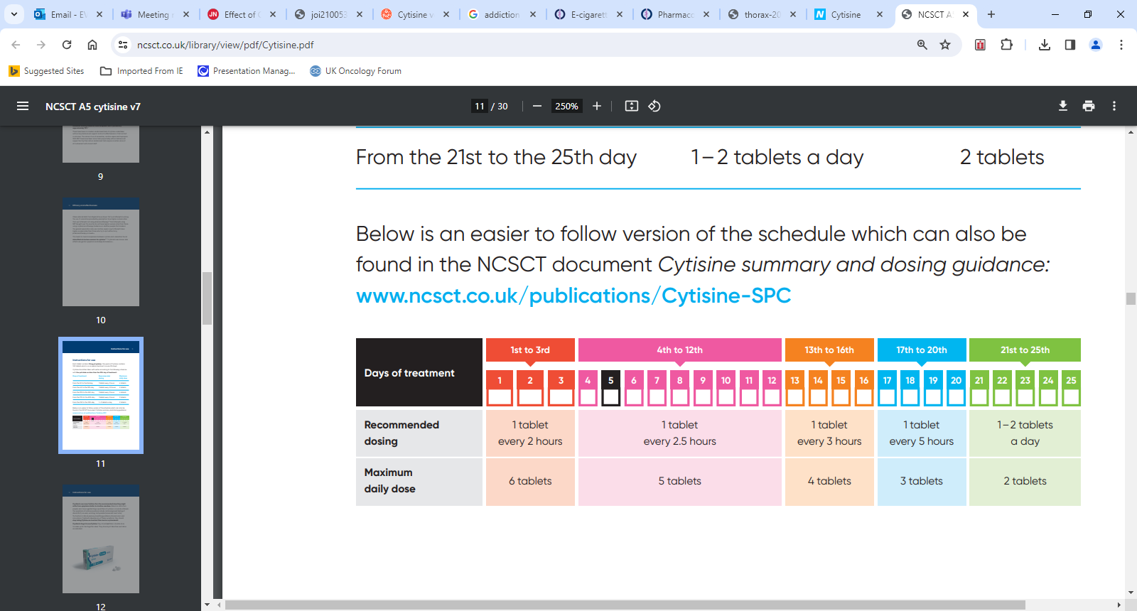
Prescribing and supplying
Cytisine is now available in the UK as a prescription only medication.
Each tablet contains 1.5mg of cytisine
One pack of cytisine contains 100 tablets
A complete treatment course is 25 days
Cytisine should be taken with water
The dose of cytisine starts at 6 tablets per day (1 tablet every 2 hours)
The dose gradually reduces over the treatment course
The aim is to reduce the number of cigarettes smoked as cytisine takes effect and helps control the urges to smoke. Ideally, this is on day 5 (if possible)
Note: Evidence suggests a 12-week treatment might be effective than the prescribed 25 days. Dosing beyond 25 days up to 12 weeks may be considered for enhanced effectiveness, although this is outside MHRA marketing approval.

Slide 13
Contraindications
Contraindications
Side effects
Allergy to cytisine or any other ingredient
Pregnancy and breastfeeding
Unstable angina
Recent myocardial infarction
Significant cardiac arrythmia
Recent stroke
Current treatment with TB antibiotics
Sleep disturbance – insomnia, abnormal dreams, nightmares
Gastro-intestinal symptoms – sickness, heartburn, constipation, diarrhoea, abdominal pain
Change in appetite – often increase
Mood changes – irritability, anxiety
Most side effects occur at the beginning of the therapy and resolve along with its duration.
These symptoms are also common when anybody stops smoking (withdrawal symptoms), regardless of treatment with cytisine.
Healthcare professionals are encouraged to report suspected side effects via the Yellow Card scheme, www.mhra.gov.uk/yellowcard
Recommendations
Cytisine isn’t recommended (lack of clinical safety data):
Aged <18 years or >65 years
Renal impairment
Liver impairment

Slide 14

Cytisine in hospitalised patients
Cytisine is a highly effective treatment for tobacco dependency
Hospitalised patients that smoke should be considered for treatment with cytisine by doctors, prescribing nurses and tobacco dependency specialists
The initiation of combination NRT at the point of admission is a standard of care across the country for any patients that smokes (immediate treatment of nicotine withdrawal)
Cytisine can be started as an inpatient and NRT used to provide the additional nicotine in the early stages of treatment that continued smoking would normally provide, aiming to stop NRT on day 5
Ongoing smoking or NRT use beyond day 5 of cytisine treatment could risk adverse symptoms of nicotine excess but there is also a risk of relapse without adequate nicotine treatment

Slide 15
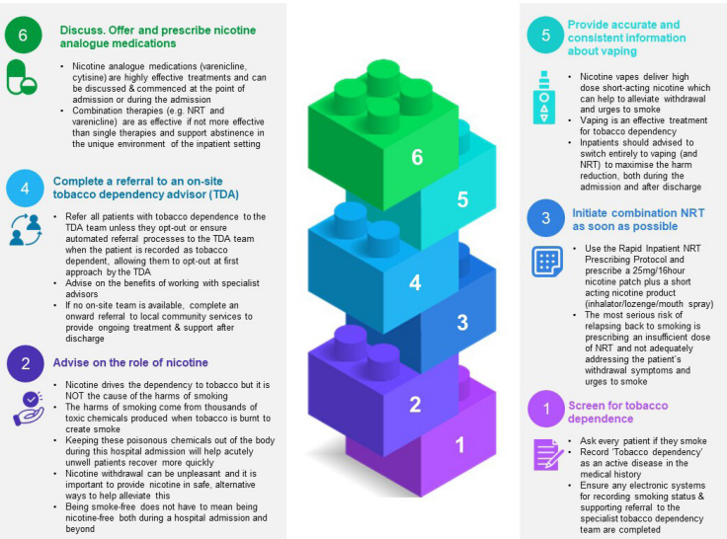

Building Block
British Thoracic Society Clinical Statement:
The Medical Management of Inpatients with Tobacco Dependency
The ‘Building Block Framework’

Slide 16
Conclusions
Key advantages of cytisine:
Plant based, naturally occurring chemical
Robust evidence of effectiveness
25-day course can be provided in a single prescription / supply
Cost saving versus other treatment courses
Less side effects compared to other nicotine analogues
This is an exciting opportunity to support more people that smoke in Greater Manchester and beyond to achieve long term abstinence from tobacco.
We must embed cytisine into routine clinical care alongside specialist support, NRT and nicotine vapes to maximise the substantial benefits from treating tobacco dependency effectively.

Slide 17

Supportive documents
Greater Manchester Medicines Management Group Guideline for the Medical Management of Tobacco Dependency
NICE Guideline NG209 Tobacco: preventing uptake, promoting quitting and treating dependence
NCSCT Briefing and Practice Guidance: Cytisine

Slide 18

Thank you for listening
Any questions please contact: gmhscp.makingsmokinghistory@nhs.net

