Slide 1




Greater Manchester Make Smoking History Programme
Educational Seminars Series
Optimising the treatment of tobacco dependency Varenicline
November 2024
These slides have sound. Please watch with sound on
Professor Matthew Evison
Consultant Chest Physician
Specialty Lead, Lung Cancer & Thoracic Surgery Directorate, Wythenshawe Hospital, Manchester University NHS Foundation Trust
Associate Medical Director, Greater Manchester Cancer
Clinical Lead, Make Smoking History, Greater Manchester Regional Tobacco Control Programme, NHS Greater Manchester
MASHC Honorary Clinical Chair, Faculty of Biology, Medicine & Health, University of Manchester

Slide 2
Objectives
To explore the evidence-base for varenicline in treating tobacco dependency
Review prescribing guidance and recommendations
Explore misinformation and myths about varenicline
Support the development of confidence & competence in discussing (& prescribing) varenicline in all healthcare professionals

Slide 3

The tobacco pandemic
& The tobacco tragedy

Slide 4
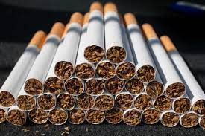
The scale of the tobacco pandemic……
Smoking tobacco is both uniquely addictive and uniquely dangerous
Two in three people that smoke tobacco will die prematurely as a direct result of the harms of tobacco
For every person that dies a further thirty will suffer from the serious diseases of smoking
In the UK, smoking tobacco has led to the death of more than 8 million people in the last 50 years
Without urgent action a further 2 million will die in the next 50 years.
Smoking disproportionately affects the poorest communities
Manchester: population 500,000
8000 households (15,000 people) in Manchester would be lifted out of poverty if the cost of smoking was returned

Slide 5
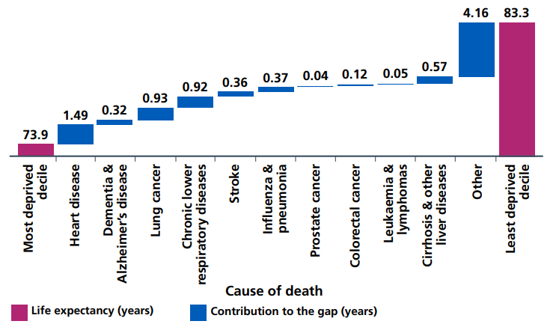
Smoking-related ill-health inequalities

Slide 6
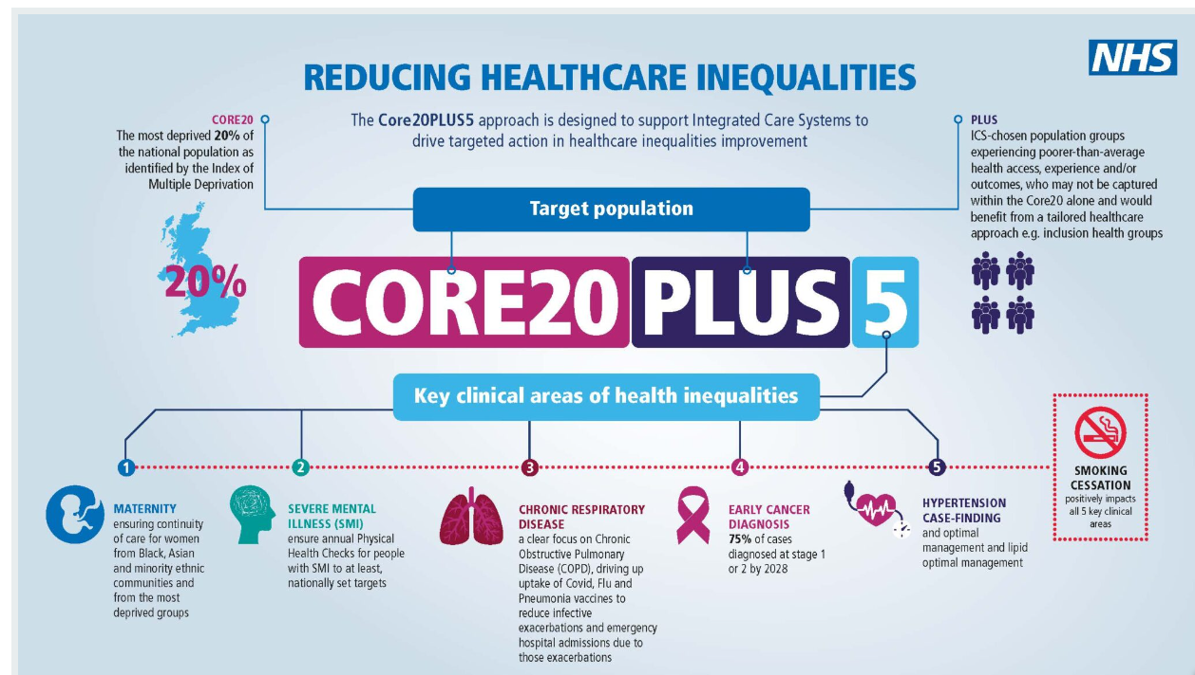

Slide 7

Why are we discussing varenicline now?

Slide 8

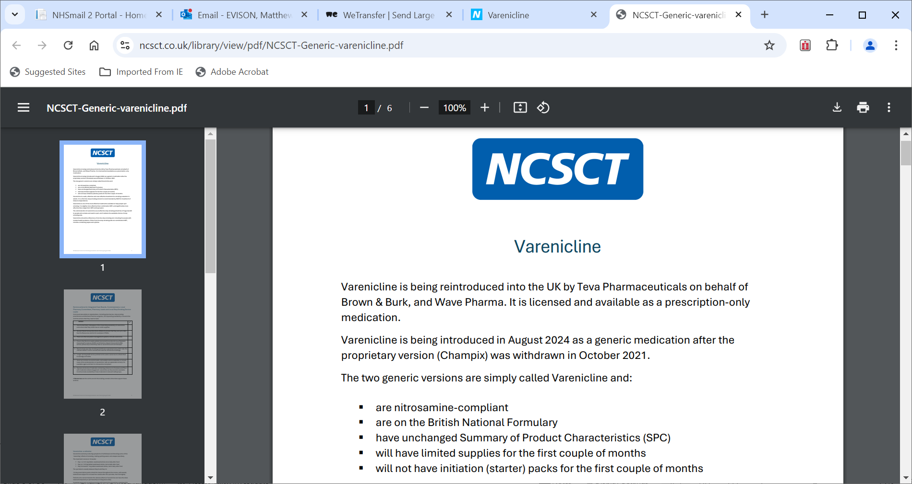
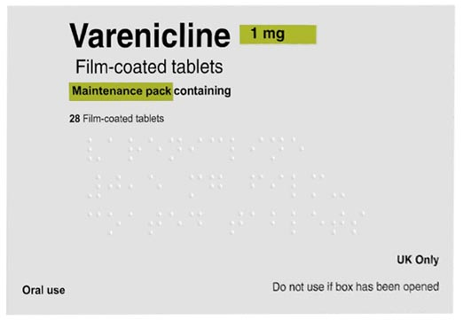
Valenicline

Slide 9

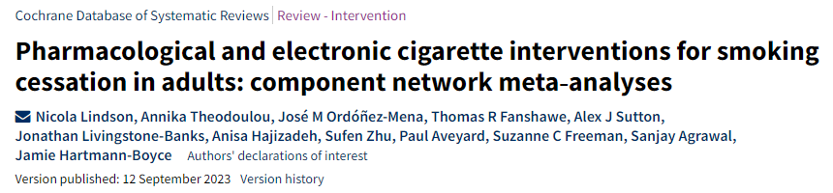
The Cochrane review
High‐certainty evidence that…….
  Nicotine vapes (OR 2.37, 95% CI 1.73 to 3.24; 16 RCTs, 3828 participants)
  Varenicline (OR 2.33, 95% CrI 2.02 to 2.68; 67 RCTs, 16,430 participants)
  Cytisine (OR 2.21, 95% CrI 1.66 to 2.97; 7 RCTs, 3848 participants)
Misinformation
Available
Available
…..were associated with higher quit rates than control.
E-cigarettes, varenicline and cytisine are the most effective stop-smoking aids, analysis of over 150,000 smokers reveals
*On average, for every 100 people trying to quit, around 14 are likely to succeed using an e-cigarette, valenicline or cytisine in any given quit attempt. This is compared to 6 in 100 who are likely to quit without using any aids.

Slide 10
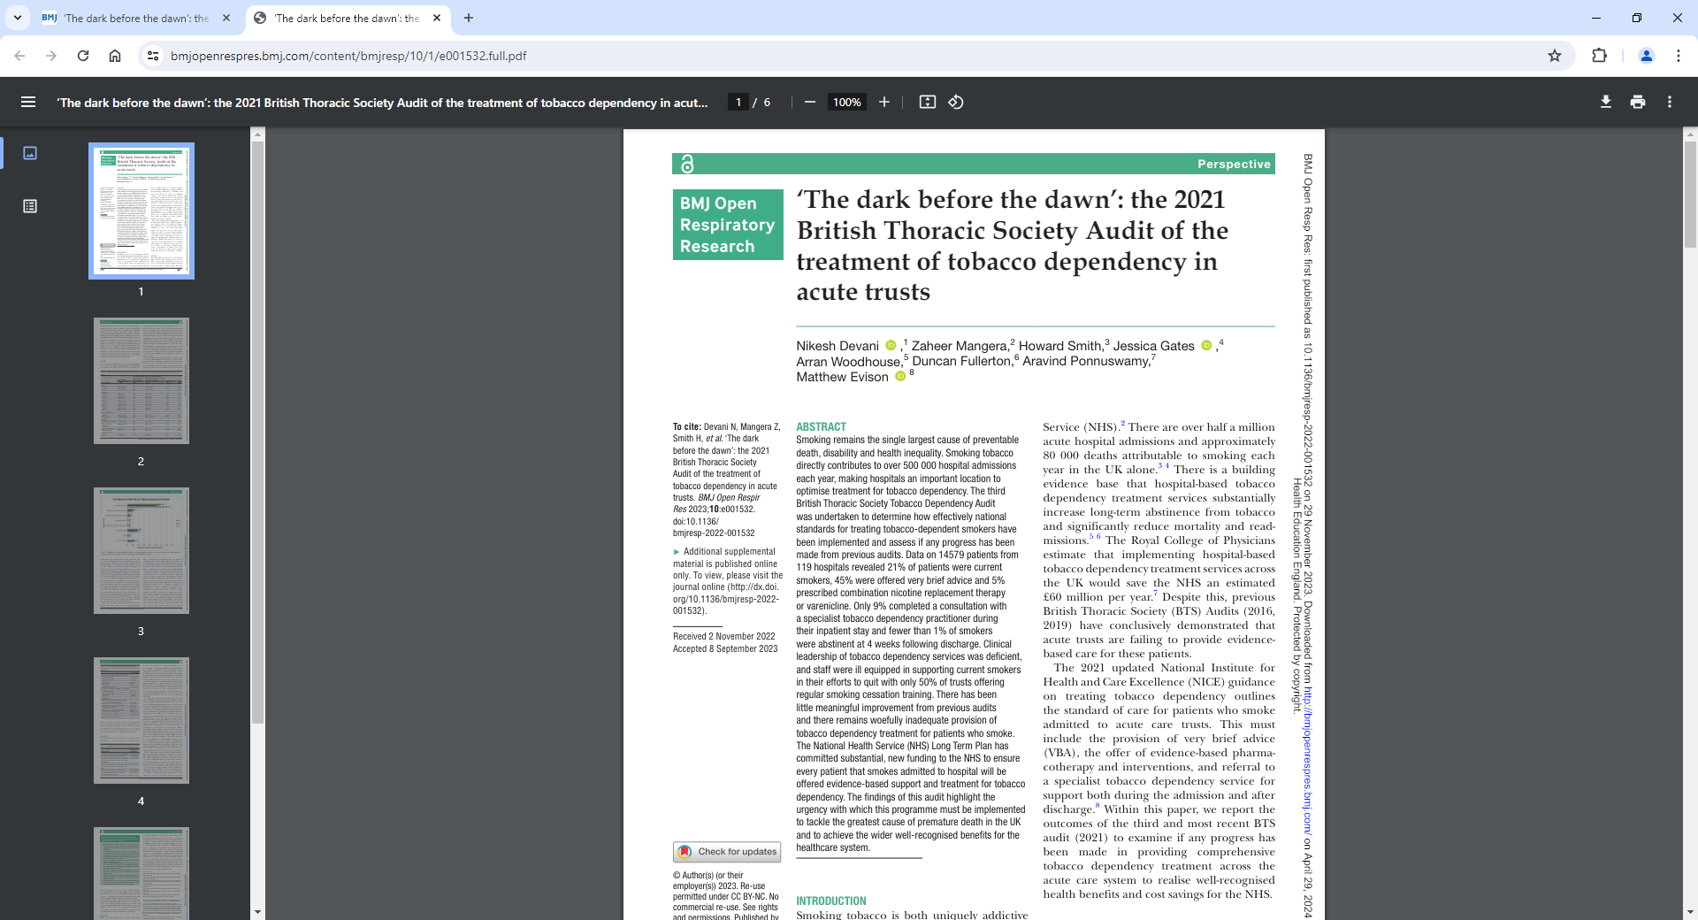
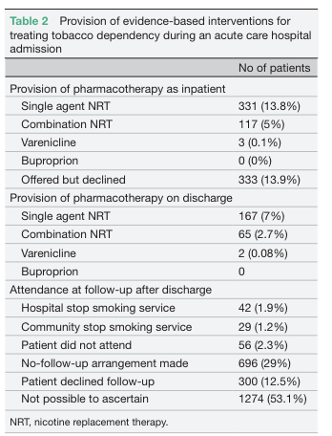
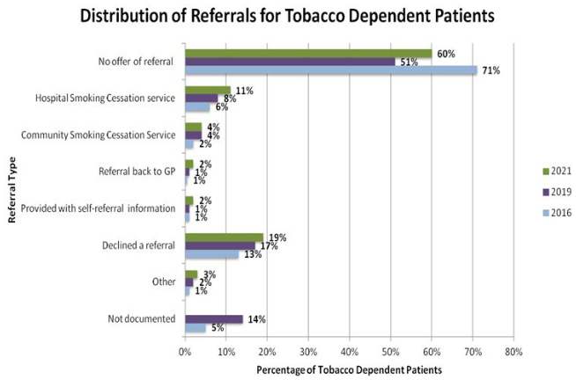
Prescribing of the past

Slide 11

A deep-dive into varenicline

Slide 12
Varenicline – medications that act on the nicotinic receptor
Dual agonist and antagonist to the nicotine receptor
Agonist = dopamine release and relief from cravings
Antagonist = prevents dopamine release from nicotine when smoking
Takes away the pleasure of smoking and the positive reinforcement of the addiction
0.5 mg once daily, day 1–3
0.5 mg twice daily, day 4–7
1 mg twice daily, day 8+
12-week course
Patient needs additional nicotine in the initial stage
Aims to gradually reduce nicotine use as medication takes effect
Set a quit date
‘Breaks the addiction to nicotine’
Can be extended to 24 weeks if high risk of relapse, eg multiple previous quit attempts
Notes:
Lets now look at the non-nicotine medications. There are two called varenicline (trade name Champix) and bupropion (trade name Zyban)
Varenicline is a dual agonist and antagonist to the nicotine receptor in the brain. So it binds to the nicotine receptor and causes dopamine release and helps to relive the cravings for nicotine without smoking. It is also an antagonist so it stays bound to the receptor and stops dopamine being released in response to nicotine from smoking. This means if a person smokes whilst taking varenicline it prevents the positive feelings caused by dopamine release and ‘takes away the pleasure of smoking’. This also helps to separate the habit and reward cycle where the action of smoking leads to positive reinforcement through dopamine release.
Bupropion is thought to be an antagonist to the nicotine receptor though the mechanism of smoking cessation is not fully understood. In in an anti-depressant that was found to lead to smoking cessation in some individuals.

Slide 13

There is a wealth of evidence of efficacy of varenicline……..
Varenicline is an effective treatment for tobacco addiction increasing the chance of abstinence by over 200% vs placebo (RR 2.24, 95% CI 2.06–2.43) (based on 27 trials with 12,625 patients).
Cahill K et al. Cochrane Database Syst Rev 2016;2016(5):CD006103
Varenicline is more effective than bupropion. Smokers are approximately 40% more likely to stop with varenicline vs bupropion (RR 1.39, 95% CI 1.25–1.54) (based on 5 trials with 5,887 patients).
Cahill K et al. Cochrane Database Syst Rev 2016;2016(5):CD006103
Varenicline and behavioural support is the most effective combination to treat tobacco addiction in a meta-analysis of 115 trials and 57,000 patients. Smokers are approximately 60% more likely to stop smoking with varenicline and behavioural support than with bupropion (OR 1.56, 95% CI 1.07–2.34) and NRT (OR 1.65, 95%CI 1.10–2.12).
Windle SB et al. Am J Prev Med 2016; 51(6):1060–71
OR = odds ratio
Notes:
What are the benefits of Varenicline?
Lets look at the evidence base.
Once again we have the highest level of medical evidence with Cochrane reviews confirming that varenicline is highly effective for smoking cessation. Furthermore, there are Cochrane reviews and meta-analyses that confirmed efficacy over bupropion and efficacy over all other forms of treatments.

Slide 14
Cochrane database of systematic reviews 2016
Randomised controlled trials with a minimum 6-month follow up.
Number needed to treat (NNT) derived from pooled difference between placebo and treatment quit rates.
 | NNT to achieve additional long-term quitter vs placebo
NRT | 23 (95% CI 20–25)
Bupropion | 22 (95% CI 18–28)
Varenicline | 11 (95% CI 9–13)
Cahill K et al. Nicotine receptor partial agonists for smoking cessation. Cochrane Database Syst Rev 2016;(5):CD006103.
Notes:
A Cochrane review calculated the number needed to treat to achieve a long term quit and this also confirmed the effective of all medications but the superiority of varenicline.

Slide 15
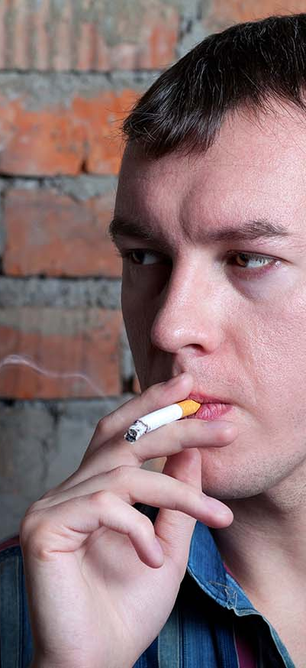

Conclusions of NICE technology appraisal 2007
Varenicline is superior to NRT and bupropion in achieving continuous abstinence (over a lifetime horizon varenicline dominated bupropion and NRT – it was cheaper and more effective – in all sensitivity analysis).
Varenicline should normally be provided in conjunction with counselling and support, but if such support is refused or is not available, this should not preclude treatment with varenicline.
When NICE recommends a treatment 'as an option', the NHS must make sure it is available. This means that, if the doctor responsible for a patient's care thinks that varenicline is the right treatment for smoking cessation, it should be available for use, in line with NICE's recommendations.
NICE. Varenicline for smoking cessation. Technology appraisal guidance 123 [TA123]. London: NICE. 2007.
Notes:
Directing quoting the words of NICE, 2007:
Varenicline is superior to NRT and bupropion in achieving continuous abstinence. Over a lifetime horizon varenicline dominated bupropion and NRT – it was cheaper and more effective - in all sensitivity analysis. Varenicline should normally be provided in conjunction with counselling and support, but that if such support is refused or is not available, this should not preclude treatment with varenicline. When NICE recommends a treatment 'as an option', the NHS must make sure it is available. This means that, if the doctor responsible for a patient's care thinks that varenicline is the right treatment for smoking cessation, it should be available for use, in line with NICE's recommendations.
Ive seen this NICE recommendation misquoted in many different forums – stating that Varenciline can only be prescribed alongside specialist behavioural support and that it cannot be prescribed without it. This is wrong and remembering the NHS constitution – we, as clinicians, are here to provide fair and equal access to the most evidenced based medications for a patients disease. Do smokers get fair and equal access to this medication and indeed all of the ones we have covered? The only way to truly to do this is for all clinicians to have confidence and competence to proactively identify smokers and offer treatment for their tobacco addiction.

Slide 16

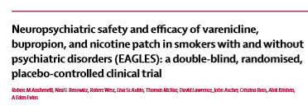
EAGLES trial
Largest trial of smoking cessation pharmacotherapy
Study requested and co-designed with the FDA
140 centres, 16 countries, 5 continents
Double-blind, triple dummy, placebo-controlled, randomised trial
Smokers aged 18–75, at least 10 cigarettes per day (cpd)
12 weeks of treatment + 12 weeks of further follow up (24-week trial)
Total 15 clinic visits – 10 minutes of smoking
cessation advice
8,144 participants randomised
Anthenelli RM et al. The Lancet 2016;387(10037):2507–20.
Notes:
The EAGLES Trial, published in The Lancet in 2016 is, I believe, one of the most important trials in the field of medicine. It is a huge international RCT that recruited over 8000 smokers. Half of whom had a history of mental health illness and half that did not. This was a comprehensive and well-designed trial that had two aims:
The find out what the best medication for tobacco addiction is by randomising participants to NRT, varenicline, bupropion and placebo. In other words this trial randomised smokers to every single treatment option for tobacco addiction in an adequately powered head to head RCT
To see if there was an increased risk of neuropsychiatric adverse events with any of the treatments for tobacco addiction.

Slide 17
EAGLES trial:
Neuropsychiatric safety outcomes
Psychiatric vs non psychiatric cohorts
Psychiatric illness stable for 3 months –
no medication changes
Psychiatric illness stratified as mood, anxiety,
psychotic, personality
Clearly defined composite outcome –
16 neuropsychiatric symptoms
‘Neuropsychiatric adverse event interview’ – 25 questions
Healthcare professional interview if ‘Yes’ to any question
8,000 patients to estimate a 75% increase in neuropsychiatric
adverse event rate within +1.59% or –1.59%
Anthenelli RM et al. The Lancet 2016;387(10037):2507–20.
Notes:
In this trial the study team went searching for neuropsychiatric adverse events through an extensive 16 symptom composite end-point and regular, detailed psychiatric evaluations during the follow up period. The trial was adequately powered to detect differences in neuropsychiatric side effects between the different treatment arms.

Slide 18
Which medication worked best?
Anthenelli RM et al. The Lancet 2016;387(10037):2507–20.
Notes:
So firstly, which medication was best.
As per all the other trials – varenicline came out on top in all cohorts and at all time points. All of the medications work but varenicline was superior to NRT and bupropion.

Slide 19

Outcomes of EAGLES trial:
Neuropsychiatric adverse events
There is no increased risk of moderate to severe neuropsychiatric adverse events with varenicline (EAGLES study 2016, The Lancet).
The act of stopping smoking carries a small risk of moderate to severe neuropsychiatric events and this is regardless of the treatment used.
The risk is higher in those with a history of psychiatric illness (5%) versus those without (2%). Advise patients to seek help in the event of a neuropsychiatric event.
In the long term, stopping smoking improves mental health disease, eg stopping smoking is more effective than antidepressants in treating depression.
Anthenelli RM et al. The Lancet 2016;387(10037):2507–20.
Notes:
And mental health side effects..
There is no increased risk of moderate to severe neuropsychiatric adverse events with varenicline. The act of stopping smoking carries a small risk of moderate to severe neuropsychiatric events and this is regardless of the treatment used. The risk is higher in those with a history of psychiatric illness (5%) versus those without (2%).
Very importantly there was a global improvement in mental health in the long term across the study cohort. The average total ‘Hospital Anxiety and Depression Score’ improved from baseline through the treatment phase by about 2 points in the non-psychiatric cohort and 3 points in the psychiatric cohort, an eﬀect that was similar across the treatment groups. This was driven by stopping smoking. Stopping smoking improves mental health and so we have a duty of care to provide these treatments to those patients that need them most – those with mental health illness. Fair and equal access for all patients to the most evidenced based treatments.
The main message we must give to smokers trying to stop is that if there are struggling with mental health symptoms they must get help! It wont last forever and in the long run mental health will be much improved.

Slide 20
Common side effects
Contraindications
Contraindications
Vivid dreams
Nausea (take with food and water)
Sleep disturbance
Headaches
Nasopharyngitis
Dose can be reduced to 0.5 mg twice daily if intolerable side effects
Pregnancy
Breastfeeding
End-stage renal failure (eGFR <10mL/min/1.73m²)
Mental health illness is NOT a contraindication
Drug intearactions
Nil
Notes:
Varenicline is generally a very well tolerated medication
It is straight forward to prescribe with little in the way of contra-indications (dialysis dependent renal failure and the licence states pregnancy & breastfeeding for no other reasons that a lack of studies / use in this cohort).
There are common side effects. Like 24 hour nicotine patches, varenicline is working overnight so can disturb sleep. It can also cause vivid dreams – not necessarily nightmares but vivid colourful dreams. It is important to inform patients about this, that it is nothing to worry about and perfectly normal with this medication. It can sometimes cause nausea so advise patients to take the tablets with food and water. If the side effects are significant but the medication is working the dose can be reduced to 0.5mg BD (half dose).

Slide 21
Systematic review and network meta-analysis:
Effectiveness of treatments for tobacco dependency 2021
October 2021
Comparative clinical effectiveness and safety of tobacco cessation pharmacotherapies and electronic cigarettes: a systematic review and network meta-analysis of RCTs, Thomas et al 2021

Slide 22

A standardised & structured intervention: The BTS framework
A new standard of care
Treating tobacco dependence in patients admitted to hospital leads to substantial benefits for both the individual and the healthcare system and
is now a standard of care in the NHS

Slide 23


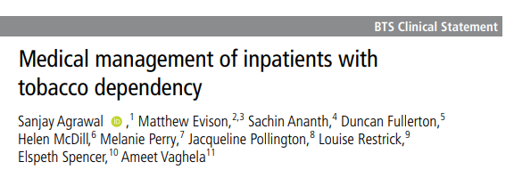
A standardised & structured intervention
https://www.brit-thoracic.org.uk/quality-improvement/clinical-statements/medical-management-of-inpatients-with-tobacco-dependency/

Slide 24

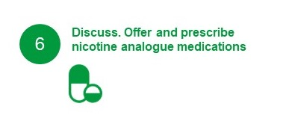
The Framework: Block by block
Block 6 - Discuss. Offer and prescribe nicotine analogue medications
Nicotine analogue medications (varenicline, cytisine) are highly effective treatments and can be discussed & commenced at the point of admission or during the admission
Combination therapies (e.g. NRT and varenicline) are as effective if not more effective than single therapies and support abstinence in the unique environment of the inpatient setting
1
1
1

Slide 25
Conclusions
Smoking tobacco is the single biggest cause of illness, disability, inequality and death
Tobacco is a life-threatening disease and must be given the urgent clinical priority it deserves
It is our duty as healthcare professionals to provide high quality, evidence-based treatment and support for any patient that smokes, at any touchpoint with the healthcare service
Varenicline is a highly effective (one of the most effective) treatments for tobacco dependency
We must discuss, offer & prescribe varenicline at a scale not previously seen in the NHS

Slide 26
Thank you for listening

