Slide 1






Greater Manchester Make Smoking History Programme
Educational Seminars Series
Vaping: ​A healthcare professional guide
November 2024
These slides have sound. Please watch with sound on
Professor Matthew Evison
Consultant Chest Physician
Specialty Lead, Lung Cancer & Thoracic Surgery Directorate, Wythenshawe Hospital, Manchester
University NHS Foundation Trust
Associate Medical Director, Greater Manchester Cancer
Clinical Lead, Make Smoking History, Greater Manchester Regional Tobacco Control Programme,
NHS Greater Manchester
MASHC Honorary Clinical Chair, Faculty of Biology, Medicine & Health, University of Manchester

Slide 2

Objectives
To explore the current evidence-base around vaping as a tool to treat tobacco dependency
To help clinicians understand how to embed vaping into treatment pathways in their practice
Explore controversies, myths and debates about vaping
Overview:
The starting point: the tobacco pandemic & the tobacco tragedy
Vaping the theory
A deep-dive into vaping into tobacco dependency
An example of a treatment pathway inclusive of vaping
Common grounds

Slide 3

The tobacco pandemic
& The tobacco tragedy

Slide 4
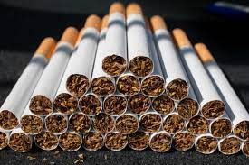
The scale of the tobacco pandemic……
Smoking tobacco is both uniquely addictive and uniquely dangerous
Two in three people that smoke tobacco will die prematurely as a direct result of the harms of tobacco
For every person that dies a further thirty will suffer from the serious diseases of smoking
In the UK, smoking tobacco has led to the death of more than 8 million people in the last 50 years
Without urgent action a further 2 million will die in the next 50 years.
Smoking disproportionately affects the poorest communities
Manchester: population 500,000
8000 households (15,000 people) in Manchester would be lifted out of poverty if the cost of smoking was returned

Slide 5
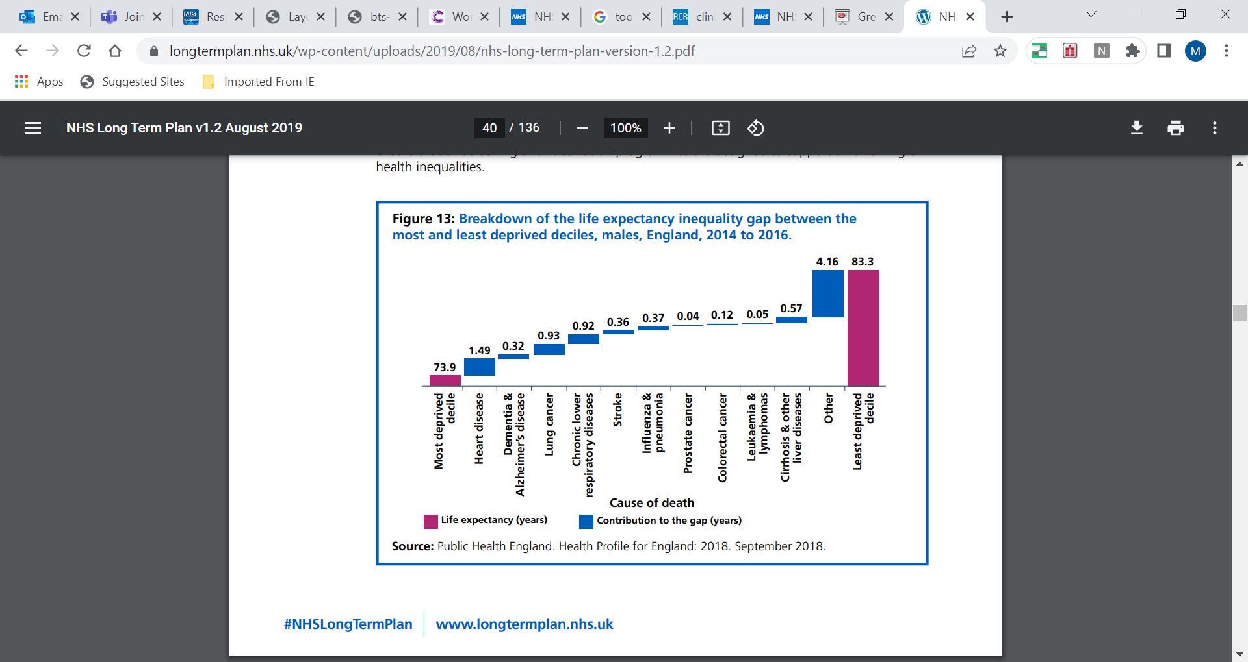
Smoking-related ill-health inequalities

Slide 6
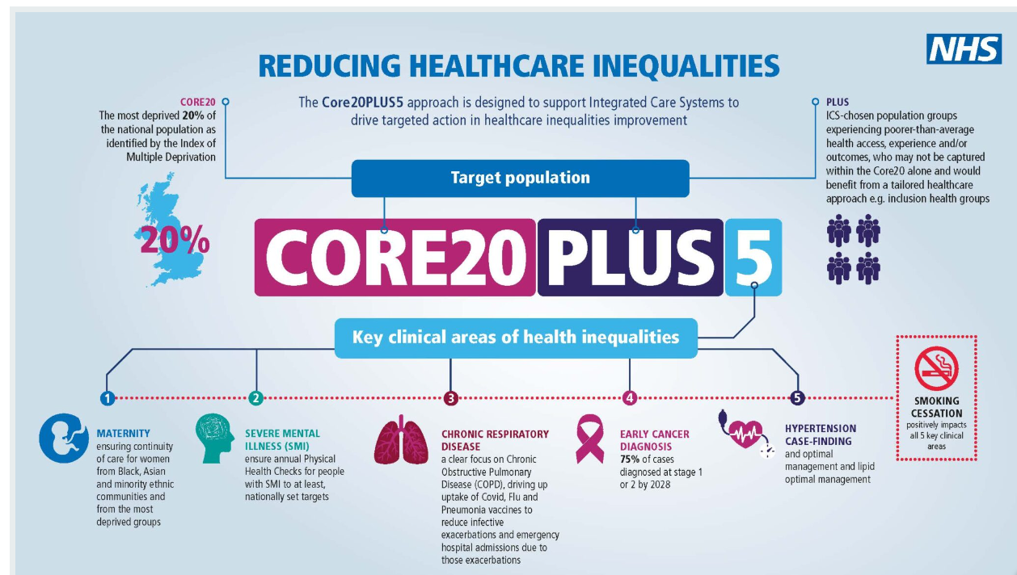

Slide 7
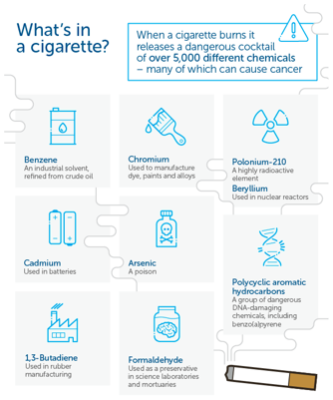
The Nicotine myth
Nicotine is a relatively harmless drug
Highly addictive in the brain but
otherwise very similar to caffeine
NICE Public health guideline 45
Nicotine causes:
X No increase in serious adverse events
X No increase cardiovascular events
X No increase in cancer
X No increase in mortality
Adverse events common but not severe, e.g. nausea, light-headedness
National Institute for Health and Care Excellence.
Smoking: harm reduction. Public health guideline 45 [PH45]. London; NICE, 2013.
Reproduced with permission from Cancer Research UK. www.cancerresearchuk.org/
about-cancer/causes-of-cancer/smoking-and-cancer/whats-in-a-cigarette-0
Notes:
Now, the myth about nicotine and smoking is that nicotine is harmful. This is not true.
Whilst nicotine is the source of the dependency and addiction it is NOT the cause of death, cancer, lung disease, heart disease or any of the illnesses and devastation caused by smoking tobacco. Nicotine can cause side effects such as nausea or light-headiness, often experienced if a person smokes for the first time but these are not dangerous and rapidly subside.
When tobacco is burnt it produces a toxic cloud of poisonous chemicals that includes tar, carbon monoxide, benzene (found in petrol), formaldehyde, arsenic (poison gas), cadmium (used in batteries), polonium (radioactive substance), polycylic aromatic hydrocarbons – cancer causing chemicals and many many more. It is these chemicals, when inhaled into the body that cause all the diseases of smoking.
Public Health England confirm in their publication PH45 that nicotine causes no increase in death, cancer or cardiovascular events. It is a very similar chemical to caffeine – it causes the same mild vasoconstriction and increased heart rate that caffeine does, the difference being in the brain caffeine works on the sleep hormone adenosine and nicotine works with dopamine.
When a smoker understands the two critical pieces of information we just covered it can be an eye-opening and game-changing moment
Smoking does not help relive symptoms of anxiety and worry, it is the cause of them and those symptoms would not be there is they did not smoke
The substance that they are addicted to and crave is actually doing them no harm, it is also the other dangerous chemicals from tobacco that are doing all the harm (so why not get their nicotine a different way…???)

Slide 8

Nicotine: A powerful dependency
Top behavioral scientist at Philip Morris, a secret presentation to industry colleagues (1972):
“Without nicotine . . . there would be no smoking.”
“No one has ever become a cigarette smoker by smoking cigarettes without nicotine … Think of the cigarette pack as a storage container for a day’s supply of nicotine … Think of the cigarette as a dispenser for a dose unit of nicotine … Think of a puff of smoke as the vehicle of nicotine …
“Smoke is beyond question the most optimized vehicle of nicotine and the cigarette the most optimized dispenser of smoke.”
Nicotine: psychoactive chemical with pleasurable effects, creating a powerful dependency
Nicotine is relatively harmless & could be used for a lifetime without major adverse effects
Smoking tobacco is unrivalled as a rapid and potent nicotine delivery system
The perfect business model………..
…….If only the additional chemicals produced by the combustion of tobacco didn’t kill 2 in 3 users

Slide 9


Vaping: the theory

Slide 10

Vaping: A dawn of a new era on tobacco control? The theory….
Remove the combustion of tobacco
Maintain the inhalation of nicotine – rapid, potent delivery akin to smoking
Preserve the experience & create a truly viable alternative to smoking tobacco
Substantially reduce the burden of tobacco-related illness and mortality
Create a nicotine delivery mechanism that might align more to society’s risk appetite for harmful substances, e.g. alcohol
Be widely accessible to those that smoke (5% of people that smoke access stop smoking services)
Provide a cheaper alternative to smoking tobacco – return the cost of smoking to the people
Make smoking tobacco obsolete
Support the delivery of a tobacco free (but not nicotine-free) world

Slide 11
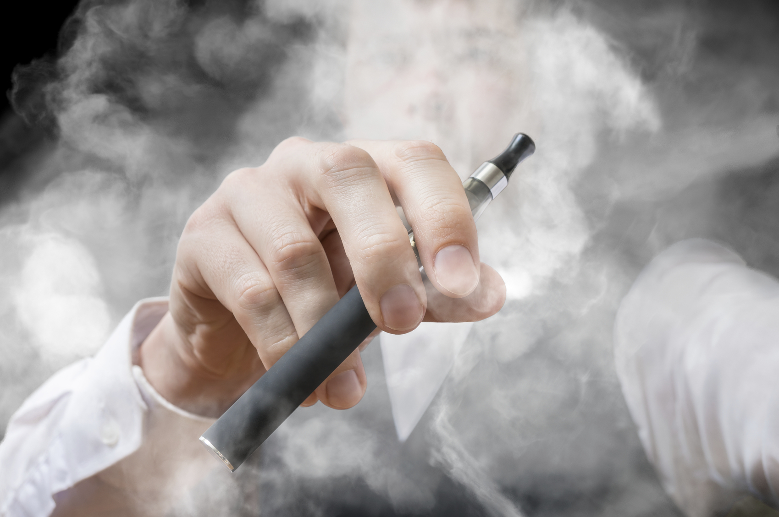
Vaping
Vaping devices contain:
Heating element
activated by inhalation
Liquid containing
Propylene glycol
glycerin
nicotine
+/- flavorings.
User Inhales the vapor created from heating
Notes:
Lets first look at the basics.
E-cigarettes are a tool to help a smoker to stop smoking tobacco. I personally do like the name e-cigarettes are they are not cigarettes and contain no tobacco.
This is a critical point that all through this presentation we have discussed the importance of helping a smoker to stop using tobacco. Tobacco is the harmful substance that produces over 5000 poisonous chemicals when burnt. Nicotine is a harmless substance and so nicotine replacement therapy aims to provide that nicotine is a safe way that isn't tobacco. NRT does not take away the nicotine dependency but it stops the user from smoking tobacco. Electronic cigarettes do the same thing and can be thought of as a different strategy of nicotine replacement. E-cigarettes heat a liquid nicotine to produce a vapour that the user inhales, hence the much preferred term ‘vaping’. The liquid is heated to approximately 300 degrees Celsius (unlike tobacco which burns at approximately 800 degrees Celsius). Therefore, inherently vaping is much less harmful than smoking tobacco. The terminology here is very important – significantly less harmful. Not safe.
The liquid contains nicotine and an alcohol-based solvent propylene glycol. Much like tar droplets facilitate nicotine transportation deep into the lungs, the alcohol droplets provide a similar nicotine transportation system. Therefore vaping is the only nicotine replacement strategy that uses alveolar absorption of nicotine like smoking. It is therefore able to provide faster and higher blood nicotine levels. Inhaling anything other than clean air into the lungs is likely to have consequences and could trigger inflammation. Propylene Glycol is the same substance used in ‘fake smoke’ in theatrical productions & theatre workers exposed to this often have higher levels of cough than other workers. Inhaling air pollution can lead to airway inflammation. So, inhaling this vapour into the lungs may have the potential to cause inflammation or worsen asthmatic airways but in comparison to the deadly damage that tobacco smoker does, it has significantly less harmful and is a way for a smoker to stop smoking tobacco.
Vaping is exceptionally popular in the UK as a stop smoking tool and over 3 million people vape in the UK. The reasons they are popular are:
The higher and faster blood levels of nicotine equates to better craving relief and reduces the change of relapsing back to tobacco
It mimics the hand to mouth action of smoking but also mimics the action of inhaling and the has the same sensation of something hitting the back of the throat which is an important part of the habit of smoking.
E-cigarettes are very readily available on most high streets. Many smokers want to stop but have not been given access to the right medications and services so look for easily accessible ways to stop smoking like vaping.
They are significantly cheaper than cigarettes

Slide 12
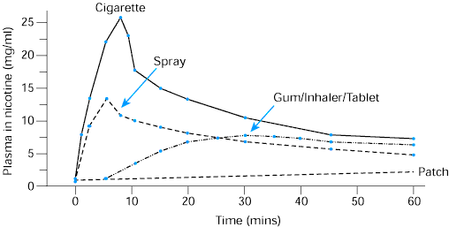
Minimisation of cravings

Slide 13
A deep dive into vaping

Slide 14
Sources of evidence to evaluate vaping...
Randomised controlled trials
Systematic reviews & meta-analyses
Cochrane reviews
A systematic review prepared and supervised by a Cochrane Review Group that identifies, appraises & synthesizes all the empirical evidence that meets pre-specified eligibility criteria to answer a specific research question. CRs use explicit, systematic methods to minimise bias & produce more reliable findings to inform decision-making. CRs are updated to reflect the findings of new evidence when it becomes available.
NICE Guidelines
Evidence-based recommendations developed by independent committees, including professionals and lay members, and consulted on by stakeholders.
Real world data e.g. Office for National Statistics

Slide 15

Randomised trial of vaping vs nicotine replacement therapy
Methods
UK NHS stop smoking services
NRT (patient choice) for up to 3 months vs an e-cigarette starter pack (a second-generation refillable e-cigarette with one bottle of 18 mg/L nicotine)
Weekly behavioural support for at least 4 weeks
Results
886 participants
1-year abstinence rate 9.9% in the NRT group
1-year abstinence rate 18.0% in the vaping group
RR 1.83; 95% CI 1.30 to 2.58; p<0.001
Among participants with 1-year abstinence, those in the
vaping group were more likely than those in the NRT group to use their assigned product at 52 weeks (80% vs 9%)
Throat or mouth irritation was reported more frequently in the vaping group (65.3% vs 51.2%)
Nausea more frequently reported in the NRT group (37.9% vs 31.3%)
The vaping group reported greater declines in the incidence of cough and phlegm
Follow-up study:
£65/QALY cost-effectiveness
Hajek P et al. N Engl J Med 2019;380:629–37
Notes:
The evidence base supports these statements.
This is a UK randomised controlled trial of vaping vs NRT, completed in UK stop smoking services and involving nearly 900 patients.
Participants were randomised to 3 months of NRT or an e-cigarette starter kit. So this was a head to head trial of NRT versus vaping. All participants received behavioural change support for at least 4 weeks as part of the study.
The result was that vaping was nearly twice as effective as NRT for smoking cessation 18% vs 9.9%
The adverse events reflect the absorption mechanism of NRT and vaping (higher rates of nausea in the NRT when swallowing nicotine leads to these symptoms) and higher rates of throat irritation from the inhalation with vaping).
There was less cough and sputum in the vaping group because there were less people smoking in the vaping arm and this further supports that although vaping itself is not risk free and is likely to cause some cough and sputum – it is significantly less harmful than smoking tobacco.
A further evaluation also demonstrated e-cigarettes to be remarkably cost-effective at £65/QALY

Slide 16

Cochrane Living Systematic Review Sept 23:
‘Nicotine e-cigarettes help people stop smoking’
There is high certainty evidence that vaping is an effective treatment for tobacco dependence using an outcome measure of long-term abstinence (at least 6 months).
Nicotine vapes are more effective than NRT (quit rates 50% higher than NRT, RR 1.63, 95% CI 1.30-2.04)
Nicotine vapes are more effective than no pharmacotherapy (quit rates 2.5 times higher, RR 2.66, 95% CI 1.52-4.65).
No evidence of harm from vaping was detected with a follow-up period of two years.
September 2023

Slide 17

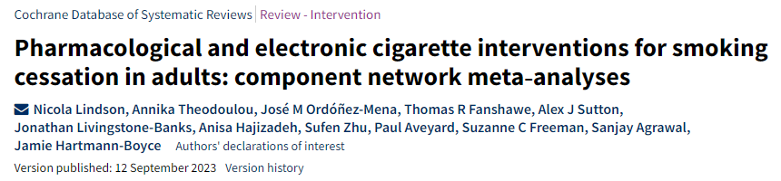
The Cochrane review
High‐certainty evidence that…….
  Nicotine vapes (OR 2.37, 95% CI 1.73 to 3.24; 16 RCTs, 3828 participants)
  Varenicline (OR 2.33, 95% CrI 2.02 to 2.68; 67 RCTs, 16,430 participants)
  Cytisine (OR 2.21, 95% CrI 1.66 to 2.97; 7 RCTs, 3848 participants)
…..were associated with higher quit rates than control.
E-cigarettes, varenicline and cytisine are the most effective stop-smoking aids, analysis of over 150,000 smokers reveals
*On average, for every 100 people trying to quit, around 14 are likely to succeed using an e-cigarette, valenicline or cytisine in any given quit attempt. This is compared to 6 in 100 who are likely to quit without using any aids.

Slide 18
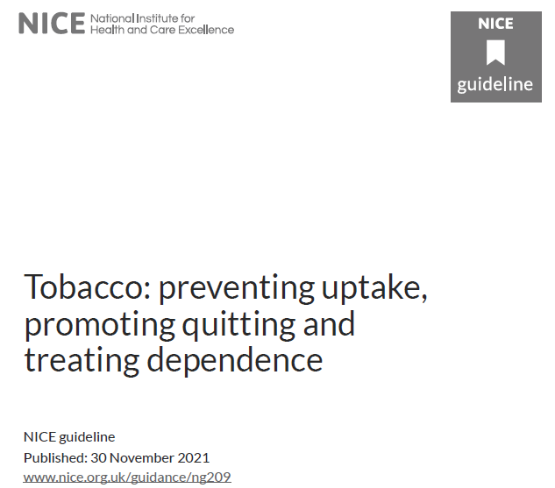
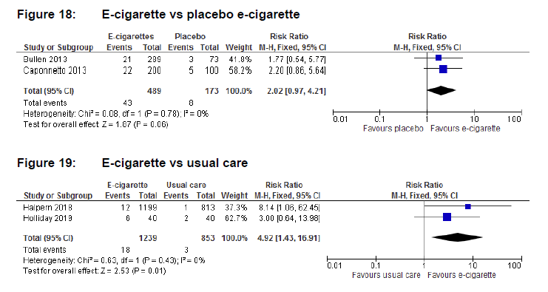
Achieving abstinence with vaping review
A systematic review and network meta-analysis on the effectiveness of vaping to achieve abstinence from smoking tobacco
Pre-defined primary outcome of abstinence at 6 months (excluded the Hajek et al RCT)
Nicotine vapes are more effective at achieving abstinence at 6 months versus non-nicotine vaping (RR 2.02, 95%CI 0.97-4.21, p0.06, two trials, 489 participants)
Nicotine vapes are more effective than usual care (RR 4.92, 95%CI 1.43-16.91, p=0.01, two trials, 1239 participants).
A benefit from combining NRT with vaping over NRT alone (RR 1.77, 95%CI 1.07-2.94, two trials, 520 participants).

Slide 19
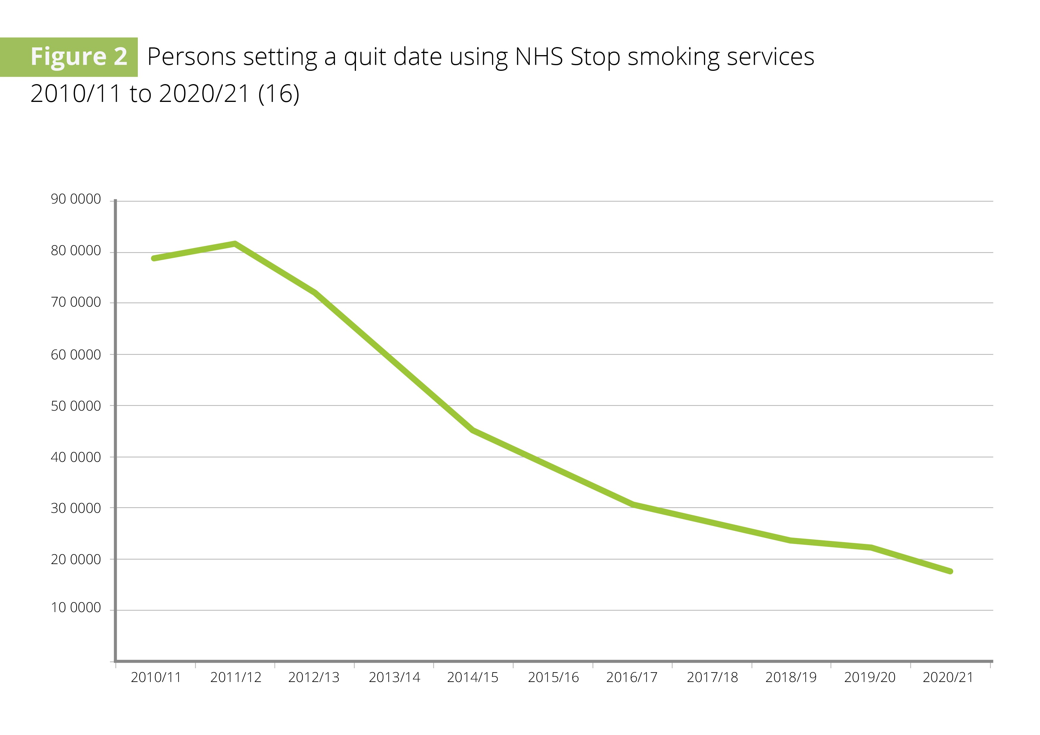
Accessibility of vaping support
‘versus usual care…’
Only 5% of people that smoke in the UK receive treatment within a tobacco dependency service
200,000

Slide 20
Real world data
Vaping has consistently been shown to be a popular stop smoking intervention in the UK.
In 2017, it was estimated that in the UK 50,700 smokers had quit smoking as a result of using vapes as an alternative method of delivering nicotine.
In 2020, 27.2% of smokers in the UK used vaping as their chosen quit aid
        15.5% for NRT
        4.4% for varenicline.
The 2021 Public Health England commissioned report on vaping products found that vaping was the most popular aid used by people trying to quit smoking, and the highest quit rates (74%) were seen when the quit attempt involved using a licensed medicine and a vaping product consecutively.

Slide 21
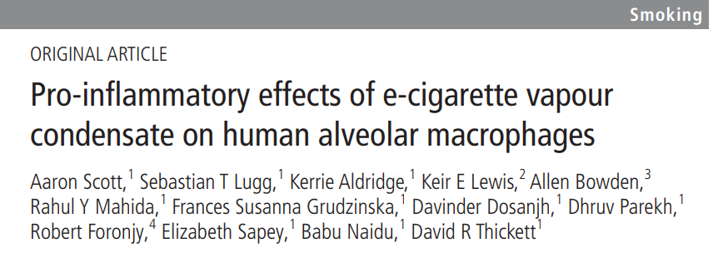
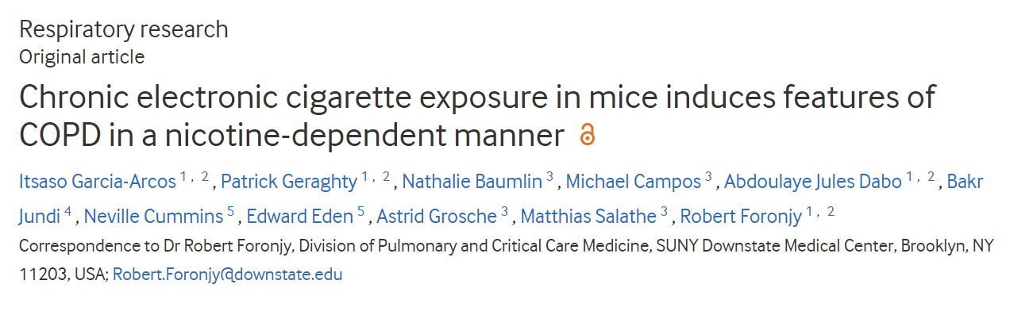
So why is there even a debate
What are the harms of vaping?
‘Harms’ without comparison to the harms caused by tobacco smoke
Translational research without real-world relevant outcomes

Slide 22
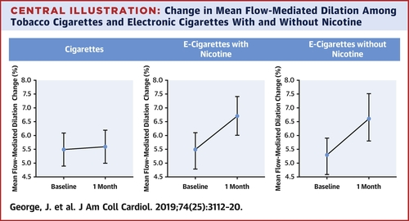

Cardiovascular effects of switching from tobacco cigarettes to electronic cigarettes
Present the harms of tobacco smoke in direct comparison with harms of vaping ……..
1% improvement in FMD = 13% reduction in risk of cardiovascular event
Jacob George et al. J Am Coll Cardiol 2019; 74:3112-3120.

Slide 23
Is vaping safe? NO buts its substantially less harmful than smoking tobacco
“There is conclusive evidence that completely substituting combustible tobacco with vaping nicotine liquid reduces users’ exposure to numerous toxicants and carcinogens present in combustible tobacco cigarettes”
US National Academy of Academy of Science, Engineering and Medicine
“Vaping is estimated to be 95% less harmful than smoking tobacco”The Royal College of Physicians
Long term: E-cigarettes have been in widespread use for less than a decade. We lack long term evidence on harms, which may yet emerge and continued vigilance is crucial.
Medium term: Bio marker studies suggest “Long-term NRT-only and EC-only use, but not dual use with cigarettes, is associated with substantially reduced levels of measured carcinogens and toxicants relative to cigarette-only smoking.” Users of EC and NRT had similar levels of measured toxicants.
Short term: RCT show little risk from EC when used short term for smoking cessation. A recent Cochrane review “did not detect evidence of harm from nicotine EC, but longest follow‐up was two years.”

Slide 24
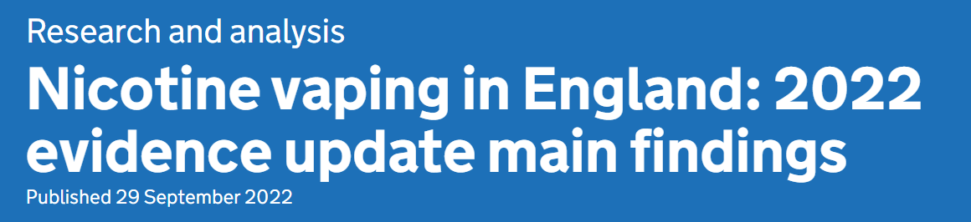
Vaping summary
Vaping: the theory
Dramatically reduce / remove the harms of smoking tobacco
In the short and medium term, vaping poses a small fraction of the risks of smoking
Vaping is not risk-free, particularly for people who have never smoked
Significantly lower exposure to harmful substances from vaping compared with smoking, as shown by biomarkers associated with the risk of cancer, respiratory and cardiovascular conditions
No significant increase of toxicant biomarkers after short-term second hand exposure to vaping among people who do not smoke or vape
In stop smoking services in 2020 to 2021, quit attempts involving a vaping product were associated with the highest success rates (64.9% compared with 58.6% for attempts not involving a vaping product

Slide 25
'Epidemic’ of vaping-induced lung injury
In the US
No regulation of e-cigarettes in the US
All cases linked to oil solvent
CBD oil, butane hash oil, vitamin E oil
In the UK
Heavily regulated e-cigarette market
No cases of death/illness
Yellow card reporting system
62 reports in 10 years from 3 million vapers
(paracetamol = 100,000 hospital admissions per year)
(1 million deaths from tobacco in the same
time frame)
Advice:
Buy from a licensed vendor
Do not buy illicit liquids
Do not buy liquids abroad
Vaping products are tightly regulated in the UK by tobacco product regulations that were adopted from the European Tobacco Products Directive and consumer product regulations.
Notes:
BUT………
In 2019 there were concerns raised over an ‘epidemic’ of vaping-associated lung Injury and deaths in America.
In the UK the vaping industry is heavily regulated so that the manufacture of products is required to be to a standard and the components of devices and liquids regulated. The UK only allows propylene glycol solvent for example. Within this regulation, there have been very few reported adverse events (adverse events are reported via the yellow card system) in the last 10 years of the vaping industry.
However, in the US there is little regulation. From a CDC investigation the cause of vaping related lung injury was vitamin E acetate – an oil used in illict liquids with cannabis – cannabis can only be dissolved in an oil solvent (not propylene glycol). Inhaling the vapour of these illicit cannabis oil liquids is highly dangerous and must be banned.
It should not however, prevent the use of vaping of regulated nicotine liquid as a smoking cessation tool. It is important that people that vape are aware they must not but illicit liquids and should only buy from registered UK vendours.

Slide 26

A standardised & structured intervention: The BTS framework
A new standard of care
Treating tobacco dependence in patients admitted to hospital leads to substantial benefits for both the individual and the healthcare system and
is now a standard of care in the NHS

Slide 27


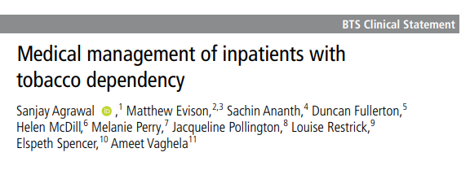
A standardised & structured intervention
https://www.brit-thoracic.org.uk/quality-improvement/clinical-statements/medical-management-of-inpatients-with-tobacco-dependency/

Slide 28

The framework: Block by block
Block 5 - Provide accurate and consistent information about vaping
Nicotine vapes deliver high dose short-acting nicotine which can help to alleviate withdrawal and urges to smoke
Vaping is an effective treatment for tobacco dependency
Inpatients should be advised to switch entirely to vaping (and NRT) to maximise the harm reduction, both during the admission and after discharge
1
1
1

Slide 29
Common ground

Slide 30
Common ground
Common ground: Tobacco is uniquely deadly and is the single most important disease to address to improve population health, respiratory health and inequalities
Common ground: Nicotine vapes are an effective treatment for tobacco dependency & are one component of a comprehensive patient-centred treatment plan
Common ground: Nicotine vapes are not risk free but are a fraction of the risk of smoking tobacco and leads to substantial net harm reduction
Common ground: Nicotine vapes are solely a treatment for tobacco dependency and have no place in society for children young adults or adults that do not smoke.
Common ground: Mice shouldn’t vape

Slide 31
Conclusions
Smoking tobacco is the single biggest cause of illness, disability, inequality and death
Tobacco is a life-threatening disease and must be given the urgent clinical priority it deserves
It is our duty as healthcare professionals to provide high quality, evidence-based treatment and support for any patient that smokes, at any touchpoint with the healthcare service
Varenicline is a highly effective (one of the most effective) treatments for tobacco dependency
We must discuss, offer & prescribe varenicline at a scale not previously seen in the NHS

Slide 32
Thank you for listening

